Slide 1
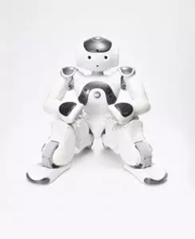
“Enhancing Physical Activity Among Older Adults Using Nao, A Socially Assistive Robot (SAR)”
What is the “likeability” and “acceptability” of Nao (a SAR) by ageing adults?
What is the effectiveness of a goal setting program consisting of interactions between Nao and the participants in increasing the frequency and quality of physical activities?
What is the effectiveness of a goal setting program consisting of interactions between Nao and the participants in decreasing the feelings of loneliness?

Slide 2
Figure 1. Logic Model
Promoting Healthy Lifestyle Among Aging Adults Through The Use A Goal Setting Intervention Mentored By Nao- A Socially Assistive Robot (SAR)”
Problems
Sedentary lifestyle of ageing adults
Theories
Social Cognitive Theory of behavioural change
Shortage of support staff in future
Objectives
Exploring the likeability and acceptability of Nao for ageing adults:
Exploring the effectiveness of the goal setting intervention delivered by Nao using RCT :
Resources and Strategies
Resources and Strategies
Offering alternative intelligent option with ongoing supports
Providing validated health intervention
Goal setting intervention for improving:
Socially Assistive Robot (SAR)- Nao
Physical activities
Social support
Experimental group
Delivered intervention by Nao, SAR
Interaction sessions between participants and SAR
Focus group with the participants with IDD
Outcomes
Needs, challenges, and opinions of ageing adults regarding SAR, Nao
The level of effectiveness of goal setting intervention for targeted variables
A psychological-based script package for human-robot interaction
A script package of goal setting intervention for SARs
A replicable RCT strategy for SAR field

Slide 3
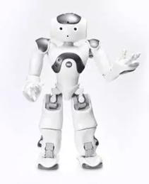
methodology
phase 1
interaction session
Focus group
Phase 2
Goal setting intervention
physical activities
walking
exercising
gardening
shopping
Working

Slide 4
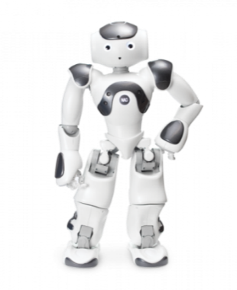
Nao’s functions
speech
Greetings
Question for hobbies, interest and memories
Remembering key info for each user
Random talk/questions
Face recognition
Emotion recognition
Adapted questions for each user
Calling the users’ name
Facial expressions for sad, happy
Providing feedback
Work recognition for emotions
Providing feedback

Slide 5
Some videos
Physical activities: Push-up; Walking
Funs: Star war, Dance, Pro Dance, Dance Training, Christmas

